Slide 1
Homework vs. Sleep
By. Amy Norton and Riley Beronja

Slide 2
Full Name__________
Gender____________
Grade_____________
How many hours of homework do you have each week?_________
How many blocks give you homework each day?_______________
Do you take AP classes?____________
How many hours a week do you sleep?
Rank what you are mostly like to do before bed: A) Read. B) Homework. C) TV. D) Listen to music
“I’m well rested throughout the day”. Strongly Agree, Agree, Disagree, Strongly Disagree

Slide 3
Population: Students at Gull Lake High School
Sample: Students that were convenient for us to survey

Slide 4
Bias
We have a few biases in our survey. We only asked students from Gull Lake High school. High school students are more likely to have homework and less likely to sleep. We also asked mostly sophomore students. Sophomore students would have a different amount of homework than students in other grades. As well, we asked mostly our friends from APUSH, which is a class that gives quite a bit of homework as well as harder homework.

Slide 5
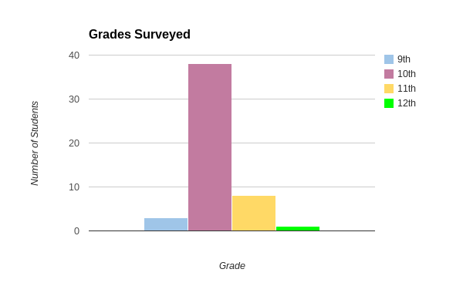
Grades Surveyed

Slide 6
Grade Summary
Of the 50 students we surveyed, a majority of them were sophomores. We also had quite a few juniors but hardly any freshman or seniors.

Slide 7
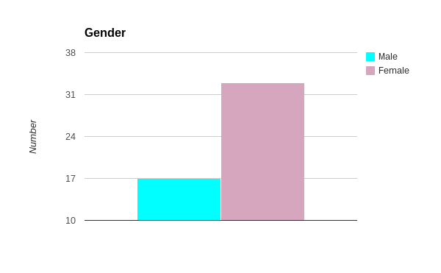
Over 50% of the students were female

Slide 8
People Surveyed
Brendan Thomas josė Carlos bendidas barnett (10)
Chris Blackmun (10) Matthew Thomas (9)
CJ Perkins (9) Stephanie Rauhoff (10)
Kadie Alpers (10) Hannah DeVore (10)
Shelby Tucker (11) Megan Morgenstern (10)
Hannah Monroe (10) Mersadies Ashby (11)
Daniel Rodriguez (10) Anna DeWaters (10)
Riley Beronja (10) Ashley Korendyke (10)
Xavier Bodus (10) Brendan Casey (10)
Amanda lee (10) Kyle Beilby (10)
Jordan VanDyke (10) Alanna Dowd (11)
Maria Rochow (10) Pablo Lopez Acosta (11)

Slide 9
Matthew Robert Peavler (11) Alexa Belanger (10)
Shawn Osborn (11) Ethan Todd Liggett (10)
Reed,Corey (10) Lily Soule (11)
Emily DeVore (12) Claire Halpin (10)
Gracie DeVore (9) Caleb Daniel Hinten (10)
Helen Foldenauer (10) Kezi Claussen (10)
Amy Norton (10) Richelle Durian (10)
Dalton Clinger (10) Jake Cole (11)
Jessie Beilby (10) Maddie Mougalian (10)
Jessie Widener (10) Kailey Konkle (10)
Emma Way (10) Janae Griffin (10)
Elise Blakely (10) Rochelle Gawel (10)
Delaney Hackman (10)

Slide 10
Of the 50 students we surveyed, 28 of them were taking advanced placement classes such as AP US History. The remaining 22 were all taking normal, grade level classes.
Taking AP classes | Not taking AP classes
28 | 22

Slide 11
How Many Blocks?
1 block | 2 block | 3 block | 4 block | 5 block
0 | 5 | 18 | 10 | 3

Slide 12
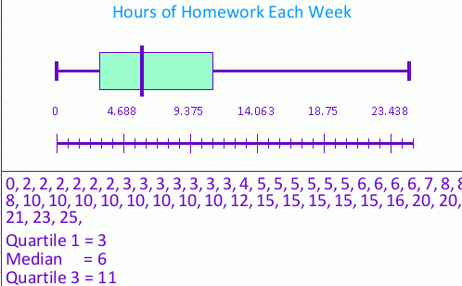

Slide 13
Mean: 8.14
Median: 6
Range: 25

Slide 14
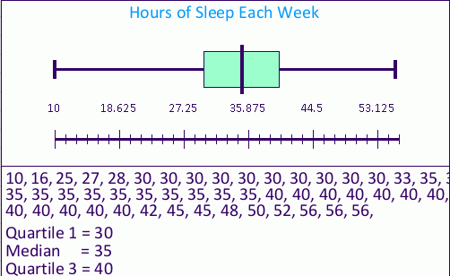

Slide 15
Mean: 36.9
Median: 35
Range: 46

Slide 16
What Do You Do Before Bed?
 | Reading | Homework | Watch TV | Listen to Music
Ranked 1st | 9 | 15 | 12 | 14
Ranked 2nd | 11 | 9 | 15 | 15
Ranked 3rd | 10 | 11 | 4 | 10
Ranked 4th | 19 | 13 | 8 | 10

Slide 17
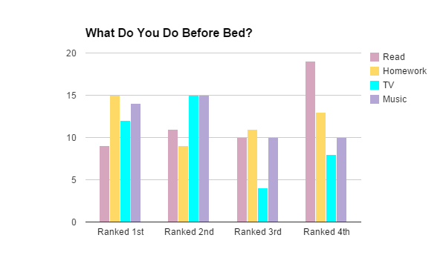

Slide 18
Homework had the highest ranking for things people would do first before bed. Followed by listening to music and watching tv. Reading being the least likely thing people would do before bed. Watching tv and listening to music were tied for what people would do second before bed. Followed by reading then homework. Doing homework was highest ranked for what people would do third, followed by reading and listening to music which were tied. People were least likely to watch tv third. People said that they were most likely to read last rather than the other four options. Followed by homework, then music, then tv.

Slide 19
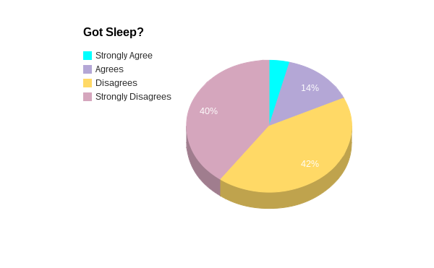
Got Sleep?
When given the statement “I feel well rested throughout the day”, more than half of the students surveyed disagreed. Most students said that they felt tired and felt that they needed more sleep. There was only a small number of students that said they did not feel the need for more sleep.

Slide 20
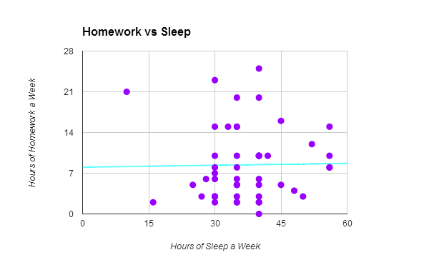

Slide 21
Regression and Equation
R: 0.0164
Equation: y = 8.041 + 0.011x
The relationship we got between homework and sleep were not very high. I believe it is not as high as we expected because there are other things, besides homework, that high school students besides sleep.

Slide 22
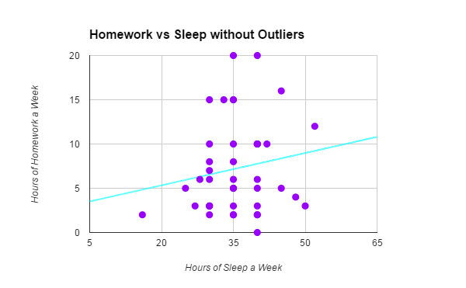

Slide 23
Regression and Equation No Outliers
R: r=0.1624
Equation: y = 2.897 + 0.122x
While the correlation did go up without the outliers it still is not a very high relationship. We believe that if we would have asked about homework as well as sports and extracurricular activities the correlation would go up.

Slide 24
Z-Scores
Z-Scores
Homework
Ethan Liggett: -0.834
Amanda Lee: -0.185
Sleep
Stephanie Raughoff: -2.882
Hannah DeVore: 0.332

Slide 25
Percentile Rank
Homework:
Claire Halpin: 66th percentile
Alexa Belanger: 88th percentile
Sleep:
Hannah Monroe: 10th percentile
Ethan Liggett: 34th percentile

Slide 26
Confidence Interval
Hours of Sleep a Week
±1.71
Hours of Homework a Week
±2.59

Slide 27
Overall Summary
The data we collected did not have a very strong correlation. We did not find a relationship between the amount of homework you have each week and the amount of sleep you get in a school week. We should have asked more people that participated in outside activities and extracurriculars. Had we factored in extracurricular activities as well as sports we may have had a stronger relationship. As many high school students wouldn’t sleep much even if they didn’t have much homework. I wish that we had asked more upperclassmen to see if your grade level also affects the amount of homework and sleep that you receive.

Slide 28
Riley’s Summary
Amy and I wrote up the survey together. I surveyed a small number of students. I created the pie chart, the two bar graphs, the two box and whisker plots, and the two tables. I also wrote up the summaries for the pie chart, two of the bar graphs, and the tables. I also included the blank survey as well as the list of people surveyed. I did the population, sample, and biases for our group of people. I also wrote part of the overall summary.

Slide 29
Amy’s Summary
Riley and I wrote the survey together. I did the majority of the surveying. I did the work with the scatter plots as well as their correlation coefficients. I also found the z-scores for some of the people surveyed. For the box and whisker plots I found the means and the ranges. I also calculated the confidence interval for both hours of homework and hours of sleep. I also wrote part of the overall summary.

