Slide 1
Histograms & all distributions
Brenan Weststrate

Slide 2
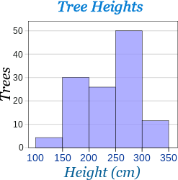
What is a Histogram?
A graphical display of data similar to a bar chart, but rather account for specific numbers, it accounts for ranges of data, I.E. histograms would account for how many times a number between 50-60 appears, rather than just the amount of times 56 appears.

Slide 3
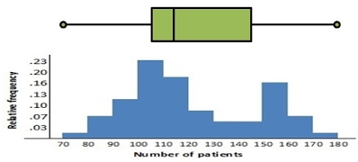
The 5-summary and how it affects histograms
Min, Q1, Med, Q3, and Max are important data points for any study using any graph involving numbers. The min shows us the absolute bottom of the barrel of what can occur, theoretically, in the said study. It should be rare to see the min have a lot of frequency, like the max. Q1 is the exact data point where you reach bottom 25% of the data. The Med contains the average of the data and displays what, on average, should be
occurring or is occurring.

Slide 4
5-num sum cont.
The Q3 is the exact point where you reach the top 25% of the data, and the max is the very top data point of the data, and theoretically should show the absolute largest amount that can occur in the said study.
No applicable image here so here's this.

Slide 5
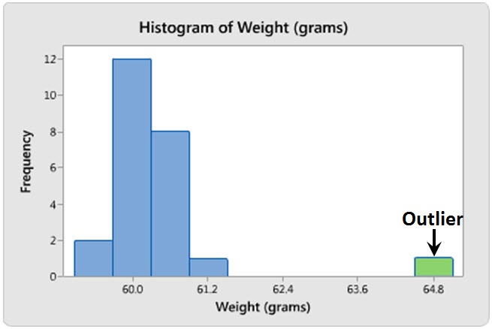
Outliers and what they do to a histogram
Luckily, outliers are very noticeable on a histogram graph, must like a bar graph. However, this can greatly mess with you Q1, Med, Q3 and Mean. A single high outlier would make your Q1, Med, Mean and Q3 all higher than what it should be and can give you disproportional statistics.

Slide 6
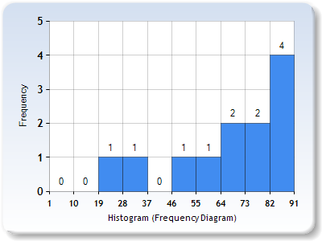
Skewness
Skewness is when data is overwhelming more frequent towards the higher end (left), or the lower end (right)
For example, data that goes like this and as shown would be skewed left
87,32,76,82,85,74,72,23,59,65,48,85

Slide 7
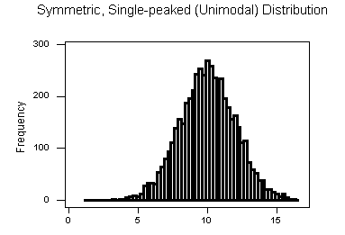
Unimodal
Unimodal Histograms have a singular peak. These are what should be expected from data. One peak, and dips further down as you continue. This is considered normal distribution. However, Skewed histograms are still considered Unimodal as they only have one peak.

Slide 8
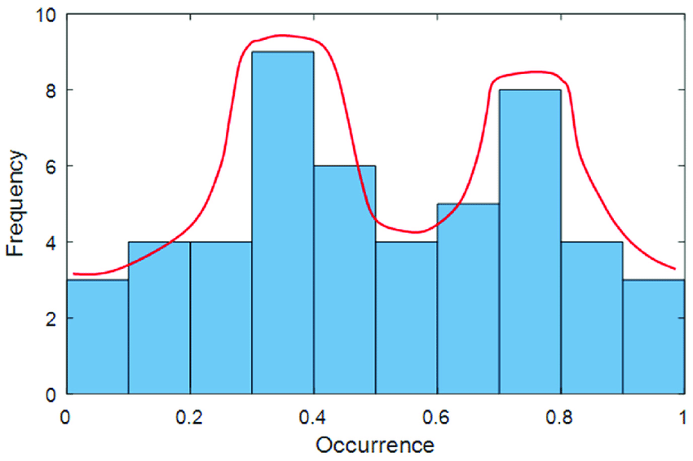
Bimodal
Bimodal Histograms occur when there is two peaks in the data, the first peak usually before the median and the second after.

Slide 9
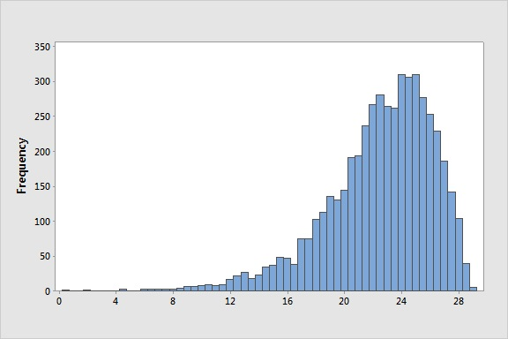
Questions
1.Why is an outlier detrimental to your data?
2.Is this histogram skewed left or right? ->
3.What is the difference between bar graphs and histograms?
4.If the outlier of a set of data is the max, what part of the 5 number summary will NOT be affected?
4.What was the monkey sipping on?

Slide 10
Normal, Binomial, Inverse, and Z-scores
By Zachary Remeur

Slide 11
Introduction to Distribution
Calculator: 2nd>Vars/Dist
PDF: Probability Distribution Function; Independent.
CDF: Cumulative Distribution Function; Dependent.

Slide 12
What is normal?
Normal Probability Density Function or Cumulative Distribution Function, is used to calculate percentages within cutoff areas or boundaries.
Syntax: Normal PDF (Lower, Upper, Mean, Standard Deviation)

Slide 13
What is Binomial?
Binomial Cumulative Distribution Function is used to compute at the value of ‘x’ using the corresponding number of trials to calculate the chance of success.
Binomial Probability Density Function is based on a specific number.
Syntax: Binomial CDF(Trials, Probability, Upper)
Upper: Up to and including
Ex. binomial cdf(7, .35, 4) or P ≤ 4 with a 35% probability.

Slide 14
What is Inverse Norm?
Inverse Normal lets the user work backwards, to get a precise value based on a known percent, using mean and standard deviation. Can be used to find the probability that a z-score is within certain cutoff values.
Syntax: InvNorm(probability, mean, standard deviation).

Slide 15
What is a Z-Score?
What is it: Standardized values, also known as ‘Z-Scores’ are found through subtracting the mean then dividing by the standard deviation. Z-scores tell us how many standard deviations a value is away from the mean.
Simply put: how far away from the mean a data point is.
Comparing Data: Z-scores allow us to compare two different values/scores even if they are from different normal distributions.

Slide 16
Questions/Review
What is the chance of getting heads 100 times, if you flip a coin 162 times?
In what situation would you use binomialCDF?
What is the difference between Cumulative Distribution Function (CDF) and Probability Density Function (PDF)?

Slide 17
Bar Charts, Pie Charts, and Stem and Leaf
By Ryan Evans

Slide 18
Bar Charts
The height of each bar shows the count for its category
Bars are also the same width, so their heights make their areas proportional to the counts in each class
There is also gaps between the bars, unlike a histogram

Slide 19
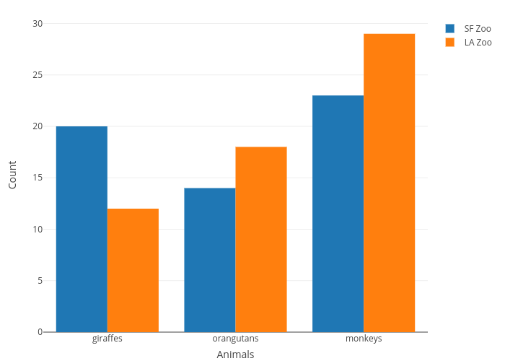
Bar Chart Example
The following is an example of a bar chart. It is a comparison of certain animals for the San Francisco Zoo and the Los Angeles Zoo, with counts for giraffes, orangutans, and monkeys. As seen below, the Los Angeles Zoo has the most animals, except for the giraffes.

Slide 20
Pie Charts
Shows the whole group of cases as a circle
They slice the circle into pieces whose sizes are proportional to the fraction of the whole in each category
Pie charts are good for seeing relative frequencies near ½, ¼, or ⅛

Slide 21
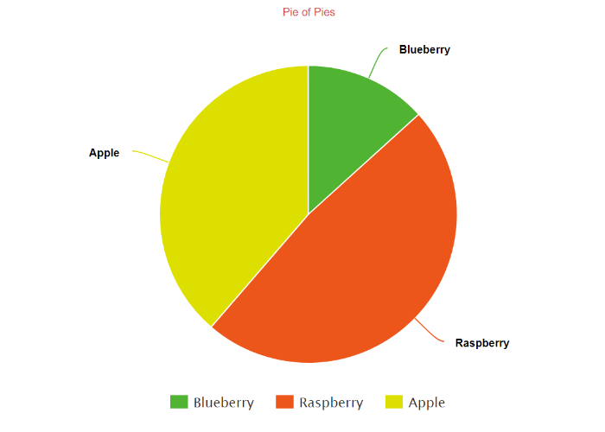
Pie Chart Example
A “Pie of Pies” shows the amount people prefer for Apple Pie, Blueberry Pie, and Raspberry Pie. Raspberry dominates about half of the pie chart, with apple taking up the majority of the other half, and blueberry ranking last among the three

Slide 22
Stem and Leaf
Unlike a histogram, a stem and leaf shows the individual values
It is like a histogram on it’s side
The tens place for the number is the “stem”, and the sliced off numbers are the leaves.
Can be useful for batches of fewer than a few hundred data values

Slide 23
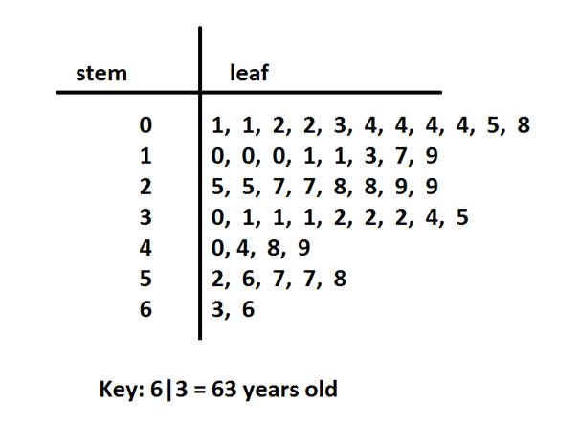
Stem and Leaf Example
Age of people surveyed. The age ranges from age 1 to age 66.

Slide 24
Question
Make a stem and lead plot of the data set:
12, 24, 38, 44, 7, 67, 88, 52, 83, 87, 17

Slide 25
Residuals
By: Dylan Gage
2nd Block

Slide 26
How to Find
L1
1
2
3
4
5
6
7
8
9
10
L2
2.5
3
3.5
4.5
5
7
7.5
8
9.5
11
L3
3
6
9
13
16
21
27
32
38
41
The formula to find residuals is: Residual = Observed - Predicted Value.
Now, let’s say you want to know what L2 and L3 would be if 2.5 was in the L1 column. Without finding the Observed Value you would use the Correlation Coefficient of 0.988 from L1 and L2 and the Correlation Coefficient of 0.994 from L1 and L3 between to find there Predicted Values. Input this data into your STAT, EDIT L1, L2, and L3 (or any open columns). The Residuals of these two equations can show which equation is a closer predictor.
You need to insert the Regression equation into Y=. This can be done by going to STAT, CALC, LingReg(ax+b) or whatever regression equation is strongest for your data. Once this LinReg(ax+b) is on your screen hit VARS, Y-VARS, Function, Y1.
It should now look like: LingReg(ax+b) Y1. Hit enter and the formula 0.94242424242424X+0.9666666666667 will be in your Y=. Do the same for the L1 and L3 formula.
.

Slide 27
How to Use
To find the predictions of L2 and L3 based off of the 2.5 in L1 you go to TBLSET and type 2.5 into TBLStart. Then to to TABLE and the Predicted Values are shown. It is 3.3227 for L2 and 7.3636 for L3. Then you find the Observed Values which are 3.35 for L2 and 7.5 for L3(this is found by actually completing the trial for your experiment with the desired number... if possible). Using the Residual equation:
L2 Residual -> 3.35 - 3.3227 = 0.0273
L3 Residual -> 7.5 - 7.3636 = 0.1364
This shows that the Correlation Coefficient between L1 and L2 is a better predictor because the residual is closer to 0. This is important for finding extremely high or extremely low numbers because they may not be possible to record for the Observed Values so they have to be estimated, and the closer the estimation the more accurate it is.

Slide 28
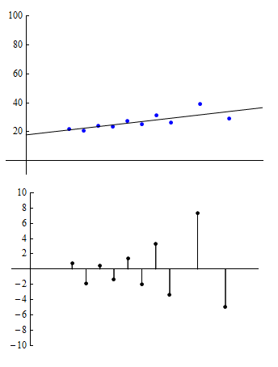
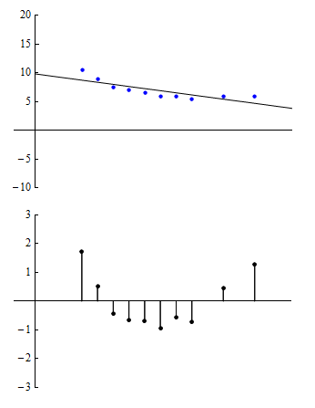
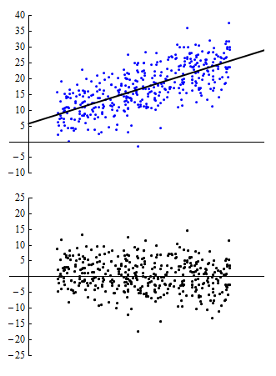
Patterns

Slide 29
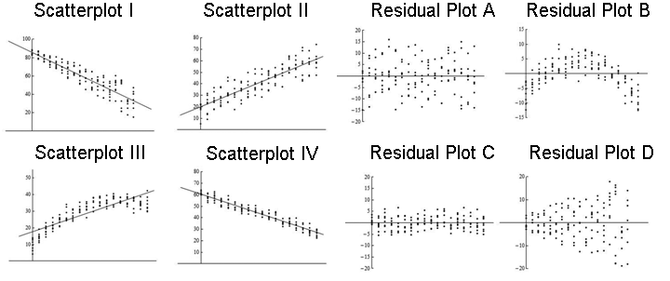
Questions
1. What is the Predicted Value of L2 be if 3.5 was in the L1 column?
2. If the Observed Value was 4.15 what is the Residual of that and the Predicted Value from the question above?
3. Match the Scatter Plot to the Residual Plot:

Slide 30
Answers
1. 4.2652
2. L2 Residual -> 4.15 - 4.2652 = (-)0.1152
3. Scatter Plot I matches Residual Plot D Scatter Plot II matches Residual Plot A Scatter Plot III matches Residual Plot B Scatter Plot IV matches Residual Plot C

Slide 31
Stats Recap
By: Grant Isom

Slide 32
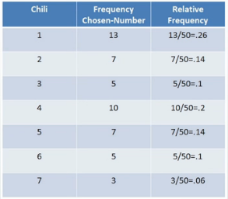
Frequency Table vs Relative Frequency Table
Frequency Table
is a method of organizing data in a compact form by displaying a series of scores in ascending or descending order, together with their frequencies
Relative Frequency
Table
is a chart that shows the popularity or mode of a certain type of data based on the population sampled. When we look at relative frequency, we are looking at the number of times a specific event occurs compared to the total number of events

Slide 33
Categorical vs Quantitative Variables
Categorical Variable
Definition: Categorical Variables are descriptions of groups or things
Examples: race, sex, age group, and educational level.
Quantitative Variable
Definition: Quantitative Variables are numerical variables
Examples: your height, your shoe size, and your weight

Slide 34
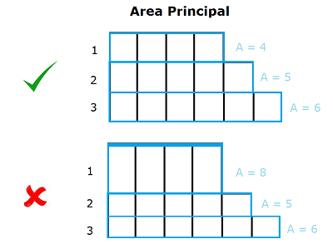
Area Principle
Definition: The area principle states that the area of a graph should equal the magnitude of the data it is representing. For a simple example, let's say you took three height measurements of 4 feet, 5 feet, and 6 feet.

Slide 35
Correlation ≠ Causation
Explanation: In Statistics when there is a strong correlation, it’s tempting to try to explain it by imagining that the predictor variable has caused the response to change.
With the example of scatterplots, correlations never demonstrates causation. At best, these statistical explanations can reveal an association between the variables. While some scatter plots do have associations there is also a high chance of overlooking a lurking variable within the graph.

Slide 36
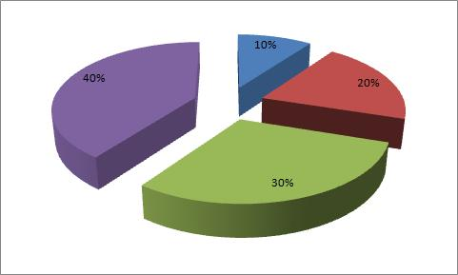
Mini Quiz
Is Religion an example of Categorical data?
If a basketball team has won 6 out of 9 games what is the frequency and relative frequency?
Does this pie chart correctly show area principle?
Why cant Correlation equal Causation?
What is the impact of a lurking variable?

Slide 37
The Five W’s
By. Emily Galbreath

Slide 38
Who
The rows of a data table are individual cases about Whom
Respondents, subjects, participants, experimental units
Often, a sample is collected from some larger population that is trying to be understood
If data doesn’t have a who the values are measured on, then the values are meaningless
Ex: People age 17, freshmen at GLHS

Slide 39
What
The characteristics recorded about each individual are called variables
Categorical or Quantitative
The variables should mention what has been measured
If we don’t know what values are measured, the values are meaningless.
Ex: Number of dogs owned, names

Slide 40
Where
Helps give us information about the context
Different parts of the world, or nation, are going to think and believe different things about a topic, so the where gives people information on what the things involved are like.
Ex: America, Asia, West coast, East coast

Slide 41
Why
Why reveals the most about our data, since it also gives insight into the Who, What, and How of the data
This is the reason why the statistics of a topic were calculated, and show people the purpose of the information.

Slide 42
When
When shows how recent and up to date the information is. It is important because a survey from the 1800's is going to display results a lot different from now.
Ex: 2013, January, Tuesday

Slide 43
How
How the data are collected can make the difference between insight and nonsense.
A one-on-one survey might give different results than an anonymous one, so some topics might require information on how the information was gathered.
Ex: Online, paper and pencil

Slide 44
Questions
Take as much as you can out of this data
Go to pg.4 in the book and use the bottom chart

Slide 45
Box & Whisker Plots

Slide 46
5 Number Summary
Min- lowest number in your data set
Q1- The middle of the portion of the data that's below the median
Median- the middle of your data set
Q3- The middle of the portion of the data that's above the data
Max- highest number in your data set

Slide 47
How to make a box plot
Our Data: 5, 7, 9, 13, 18, 12, 37, 2, and 11
Frist you need the 5 number summary for your data
Max- 37, Q3- 15.5, Median- 11, Q1- 6, and Min-2
Draw a line spanning the width of your data and draw short lines next the larger line at the lower and upper quartiles and the median connect those lines to build your box
40
30
20
10
0

Slide 48
3. Now we must create fences, we don't actually graph the fences, they are just regions for us. Place the upper fence 1.5 IQRs above Q3 and the lower fence 1.5 IQRs below Q1. IQR (Interquartile Range) is found by subtracting Q3 from Q1.
Upper whisker = Q3 + 1.5 IQR = 15.5 + 1.5 x 9.5 = 29.75
Lower whisker= Q1 - 1.5 IQR = 6 - 1.5 x 9.5 = -8.25
These fences allow us to see that anything that falls beyond them is not connected by a whisker and therefore an outlier
4. Then whiskers go out to the min and the max
Outlier
40
30
20
10
0

Slide 49
Distribution and Skewness
A box plot highlights the distribution of numbers
The central box shows the middle half of the data , between the quartiles. The length of the box is equal to the IQR. The median is roughly centered between the quartiles and the middle half of the data is roughly symmetric. If the median is not centered then the distribution is skewed. The whiskers also show skewness is they are not roughly the same length. Any outliers are displayed individually to keep out for judging skewness

Slide 50
Question
Build your own box and whisker plot with the data set:
1, 4, 7, 12, 16, 23, 29, and 52

Slide 51
Answer
Outlier
50
40
30
20
10
0
Min: 1, Q1: 5.5, Med: 14, Q3: 26 Max: 52

Slide 52
Response, Explanatory, and Lurking Variables

Slide 53
Response and Explanatory Variables
A.k.a. The dependent and independent variables
Response Variable: (Dependent or outcome variable) is predicted or explained by the explanatory variable
Explanatory Variable: Explains the response variable, is manipulated by researcher
EX. A team of biologists wants to compare the effects of two chemical plants near streams on the death rate of fish. The two plants either dump their waste in the river or in a chemical dump site. This experiment has one explanatory variable: If the plants dump their waste. The response variable is a measure of death rate in the stream.

Slide 54
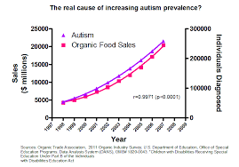
Lurking Variables
A variable that may change the outcome of a study in ways that are not immediately seen.
EX. At first glance, the graph
appears to demonstrate a correlation between
autism and organic food sales, however this does
not mean that one causes the other.

Slide 55
Standard Deviation

Slide 56
Standard Deviation
Demonstrates the spread between data points
Process:
Find the mean of the data spread
Subtract the mean from each data point and square the result
Find mean of new values
Square root result

Slide 57
Review Questions
Find the Standard Deviation: 9, 2, 5, 4, 12, 7, 8, 11, 9, 3, 7, 4, 12, 5, 4, 10, 9, 6, 9, 4
Locate the Explanatory and Response Variables
A nutritionist wants to determine if the amount of water consumed each day by persons of the same weight and on the same diet can be used to predict individual weight loss.

Slide 58
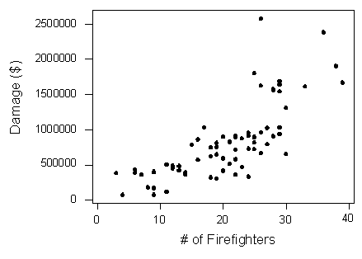
3. Could there be a lurking variable(s) in this graph? Explain.

Slide 59
Contingency tables and Marginal Distribution
By: Moneiah Burgess

Slide 60
Contingency Tables
Contingency Table: A table showing the distribution of one variable in rows and another in columns, used to study the association between the two variables.
Ex:

Slide 61
Marginal Distribution
Marginal Distribution: the frequency distribution of one of the variables.
Ex:

Slide 62
Questions
What is the marginal distribution of all left handed people?
What is the marginal distribution of all right handed people?
What is the marginal distribution of people with blonde hair given that are right handed?

Slide 63
Statistics A Review:
Scatterplots
By: Brandon Buchanan 2nd Block

Slide 64
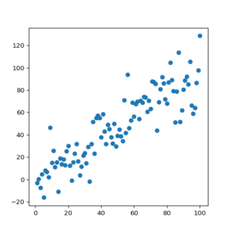
What is a Scatterplot?
A scatterplot is a graph used to show the relationship between two quantitative variables.

Slide 65
Associations
Direction: Is it moving positive, negative, or neither?
Form: Is it straight, curved, unusual, or no pattern?
Strength: Is there a lot of scatter going on?
Unusual Features: Are there any outliers or subgroups?

Slide 66
What are the variables?
Response Variable: The y value or value of interest.
Explanatory Variable: The x value.
Response
Explanatory

Slide 67
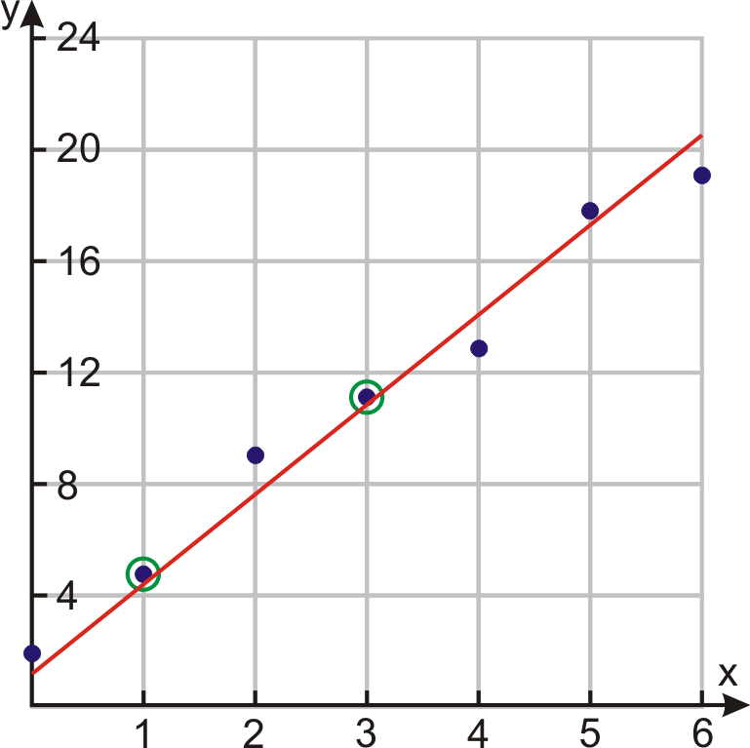
Correlation and Line of Best Fit
Correlation (r) is used to measure the strength of a linear association. Only lies between -1 and +1.
Line of Best Fit is a line that shows the sum of the squared residuals are smallest of them all. Also known as a linear regression line.

Slide 68
Predicted Value and Extrapolation
The predicted value is a point on the line of best fit that predicts the expected value based on the line. Also known as ŷ or y-hat.
Extrapolation is a predicted value that is outside of the x territory.

Slide 69
Give this a try!
Use the data below to create a scatterplot and answer the questions on the next slide (use a calculator!).
x | 1 | 2 | 3 | 4 | 5 | 6 | 7 | 8 | 9 | 10 | 19
y | 2 | 4 | 5 | 8 | 11 | 13 | 18 | 21 | 27 | 40 | ??

Slide 70
Questions
(Answers are on next slide)
What is the line of best fit (linear regression) equation?
What is the correlation coefficient?
What does this answer tell you?
What is the predicted value if the explanatory value at 19?

Slide 71
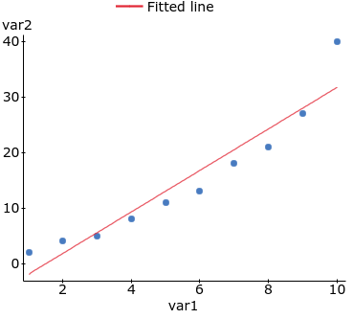
Answers
y = 3.73x - 5.6
r = 0.95
It has a very strong and positive correlation.
y = 65.22

Slide 72
Linear, Exponential, Power
Regression Notes
By: Eliot Martinon

Slide 73
Overview
The use of regressions will allow you to be able to analyze given data by making a graph with it and fitting a line of best fit based on the correlation coefficient ( r ).
In this presentation, you will be shown:
Different regressions such as Linear, Exponential, and Power
How to find the regressions with your calculator
An example problem
Extra facts about the regressions
A quiz based on the information in the presentation

Slide 74
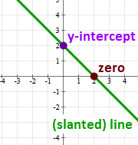
Linear
Function: y= ax+b (calculator) or y=mx+b (by hand)
Facts:
Only whole numbers
Straight line
One independent and one dependent variable
If any curves, it is not linear
The constant term is a or the y-intercept

Slide 75
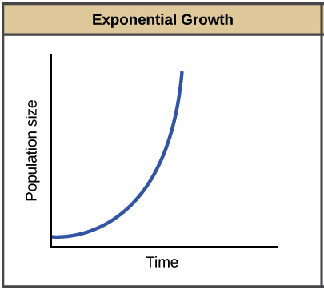
Exponential
Function: y=ab^x
Facts:
Can deal with population or percentages
(compound interest)
Instead of y=2x it is y=2^x
When b = 1, the graph is horizontal at y = a
Starts with a horizontal asymptote of y = 0

Slide 76
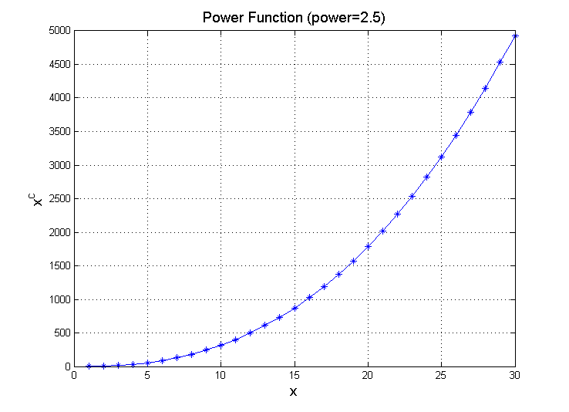
Power
Function: y=a(x^b)
Facts:
A variable raised to a fixed power
The parameter b, called either the exponent or the “power”
(determines the function’s rates of growth and decay)
Examples include Root Functions
As well as Reciprocal Functions

Slide 77
How to find them with a Calculator
(Make sure to turn diagnostics on by pressing “2nd” zero and then scrolling down, this will give you the correlation coefficient ( r )).
Step 1: Press the “stat” button on your calculator
Step 2: Click the Edit… button and it should open up a blank chart with L1, L2, L3, and etc
Step 3: Input the desired data into the chart (L1 = x, L2 = y)
Step 4: Press “2nd” mode to quit out and then push the “stat” button again
Step 5: Switch to the “calc” tab and then click “4” for linreg, “0” for expreg, or “A” for pwrreg

Slide 78
Example
X
Y
1 | 4
2 | 6
3 | 8
4 | 10
5 | 12
6 | 14
After plugging the data into your calculator,
the answers should be:
Linreg: 2x+2
Expreg: 3.52(1.28^x)
Pwrreg: 3.84(x^0.7)

Slide 79
Additional Facts (in statistics)
Regression: A measure of relation between the mean value of one variable (output) and corresponding values of other variables (time and cost)
Relationships: Relationship between two variables is referred to as their correlation, (a correlation can be positive, meaning variables move in same direction, or negative, variables go in opposite directions).
Functions: A relation between a set of inputs and a set of permissible outputs with the property that each input is related to exactly one output
( r ) : This is the correlation coefficient, it is used to tell whether or not the desired regression is the best to fit the data, the closer the number is to 1, then the better it is for the data.

Slide 80
Your Turn!
X
Y
1 | 6
2 | 8
3 | 13
4 | 17
5 | 23
6 | 25
7 | 31
8 | 40
Find LinReg, ExpReg, and PwrReg and state their formulas below (add the correlation coefficient as well ( r ))
Linreg: r =
Expreg: r =
Pwrreg: r =
Now let’s see if you read through the presentation carefully,
Using the correlation coefficient, which regression is the best fit for the data: ___Reg
Answers are on the next slide

Slide 81
Answers to short quiz
LinReg: 4.7x + -0.79 r = 0.9877
ExpReg: 5.2(1.3^x) r = 0.9847
PwrReg: 5(x^0.92) r = 0.9838
r = 0.9877
Using the correlation coefficient, the best fit for the data is the: LinReg

Slide 82
Normal Distribution
Noah Kibler

Slide 83
The first rule for normal models
Make A Picture
There are three things to make sure of when sketching a normal curve
It's shape
Bell curve
Having only 3 standard deviations spreading from the mean
Standard Deviation: a measure that is used to quantify the amount of variation or dispersion of a set of data values.
Having the inflection point exactly ONE standard deviations from the mean
Inflection Point: a point of a curve at which a change in the direction of curvature occurs.

Slide 84
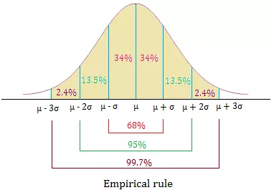
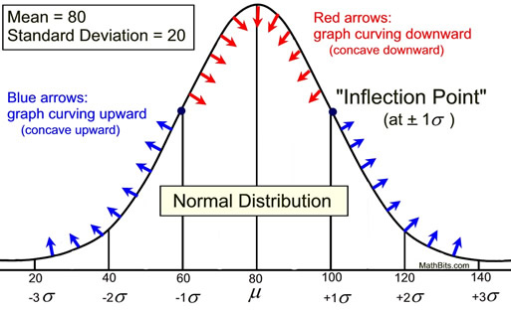
68 - 95 - 99.7 Rule
also known as the empirical rule, used to remember the percentage of values that lie within a band around the mean in a normal distribution
This rule helps describe the relationship of one point to many other points

Slide 85
Things To Note
Bell Curve
Associated with the 68 - 95 - 99.7 rule
Standard deviation formula
Once found standard deviation you can find it on the normal distribution curve
Z-Scores
A z-score indicates how many standard deviations an element is from the mean.

Slide 86
Example
Suppose you took a math test out of 100 points. The average score of the class was an 85/100 with a standard deviation of 5, you scored a 75/100 and want to find your z-score in relation to the other students.

Slide 87
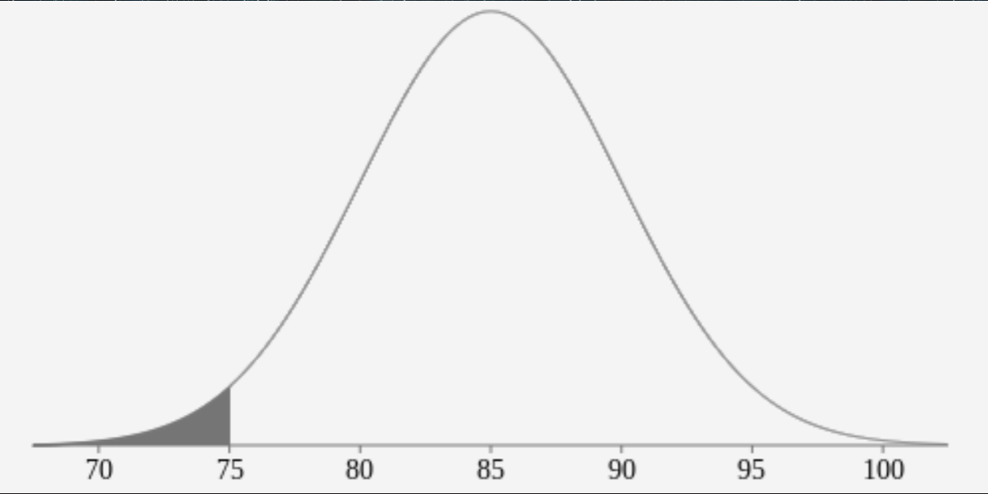
Using the formula(your score - average score)/standard deviation or (75-85)÷5 you can tell that your score is 2 standard deviations below the mean.

